Slide 1
Job interview questions

Slide 2
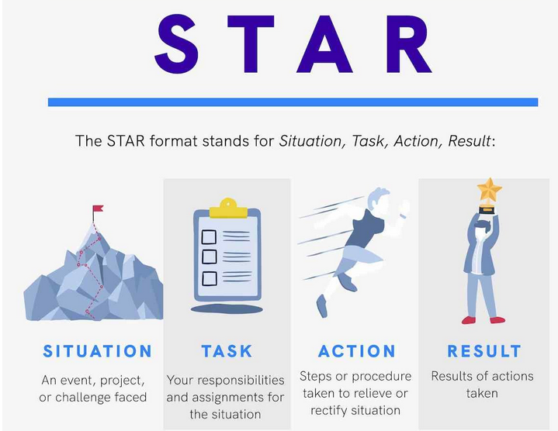

Slide 3
What makes you unique?
How would you like to change the world?
Describe yourself without mentioning anything that is on your CV.
Which technical skills do you have to offer?
Are you ready to work in an international environment?
Tell me about a time when you experienced culture clash.
What is an engineer? Why did you choose to become one?
How has your training prepared you for this job?
What are your values?
What are the three things that are most important to you in a job?

Slide 4
11. What do you look for in an employer?
12. Tell me about one of your achievements.
13. How do you see the future of your sector?
14. Tell me about a failure you experienced.
15. Which adjectives describe you the best?
16. If you could be anyone else in the world, who would you like to be?
17. If you owned or ran this company, what would you change?
18. Tell me about a time when you were asked to do something that you had never done before. How did you react? What did you learn?
19. Give an example of when you had to work with someone who was difficult to get along with. How did you handle interactions with that person?

Slide 5
20. Tell me about the last time something significant didn’t go according to plan at work. What was your role? What was the outcome?
21. Recall a time when your manager was unavailable when a problem arose. How did you handle the situation? With whom did you consult?
22. Tell me about a time when you had to juggle several projects at the same time. How did you organise your time? What was the result?

